Slide 1
DBS Acoustic Results

Slide 2
Acoustic Measures
Voicing proportion during sentences (%)
F2 Slope (Hz/ms)
Corner Dispersion (Hz)
Articulation Rate
F0 Semitone
Intensity Variation (dB)

Slide 3
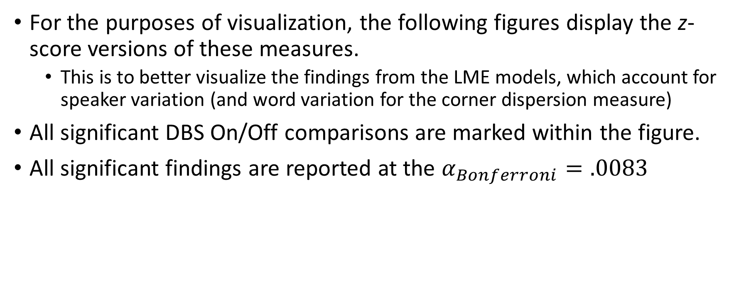
Notes
For the purposes of visualization, the following figures display the z-score versions of these measures.
This is to better visualize the findings from the LME models, which account for speaker variation (and word variation for the corner dispersion measure)
All significant DBS On/Off comparisons are marked within the figure.
All significant findings are reported at the $α_{Bonferroni}=.0083$

Slide 4
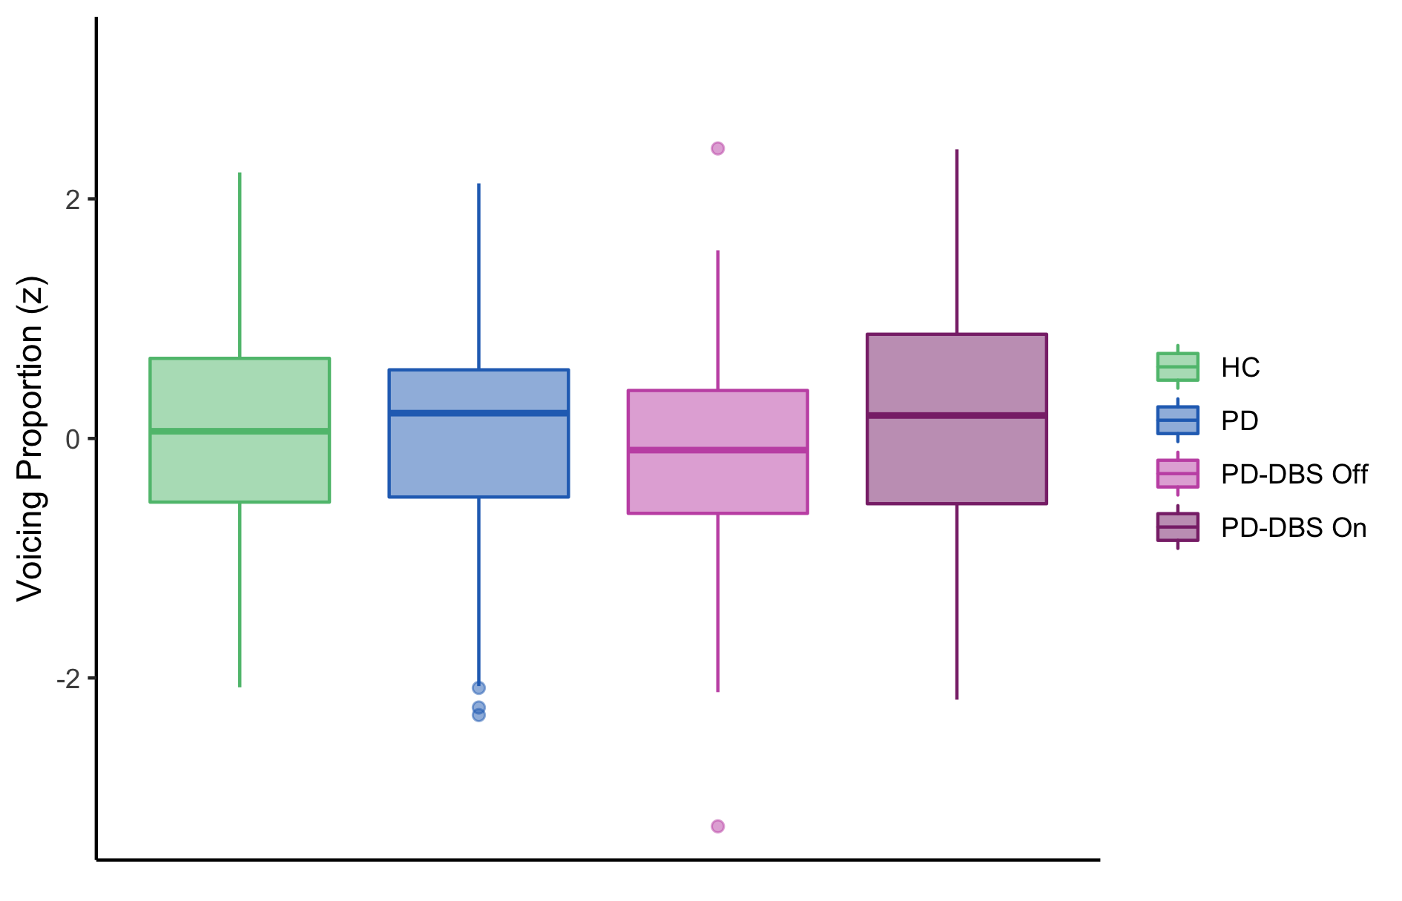
1. Voicing Proportion (%)
There was no significant DBS effect for the voicing proportion measure.

Slide 5
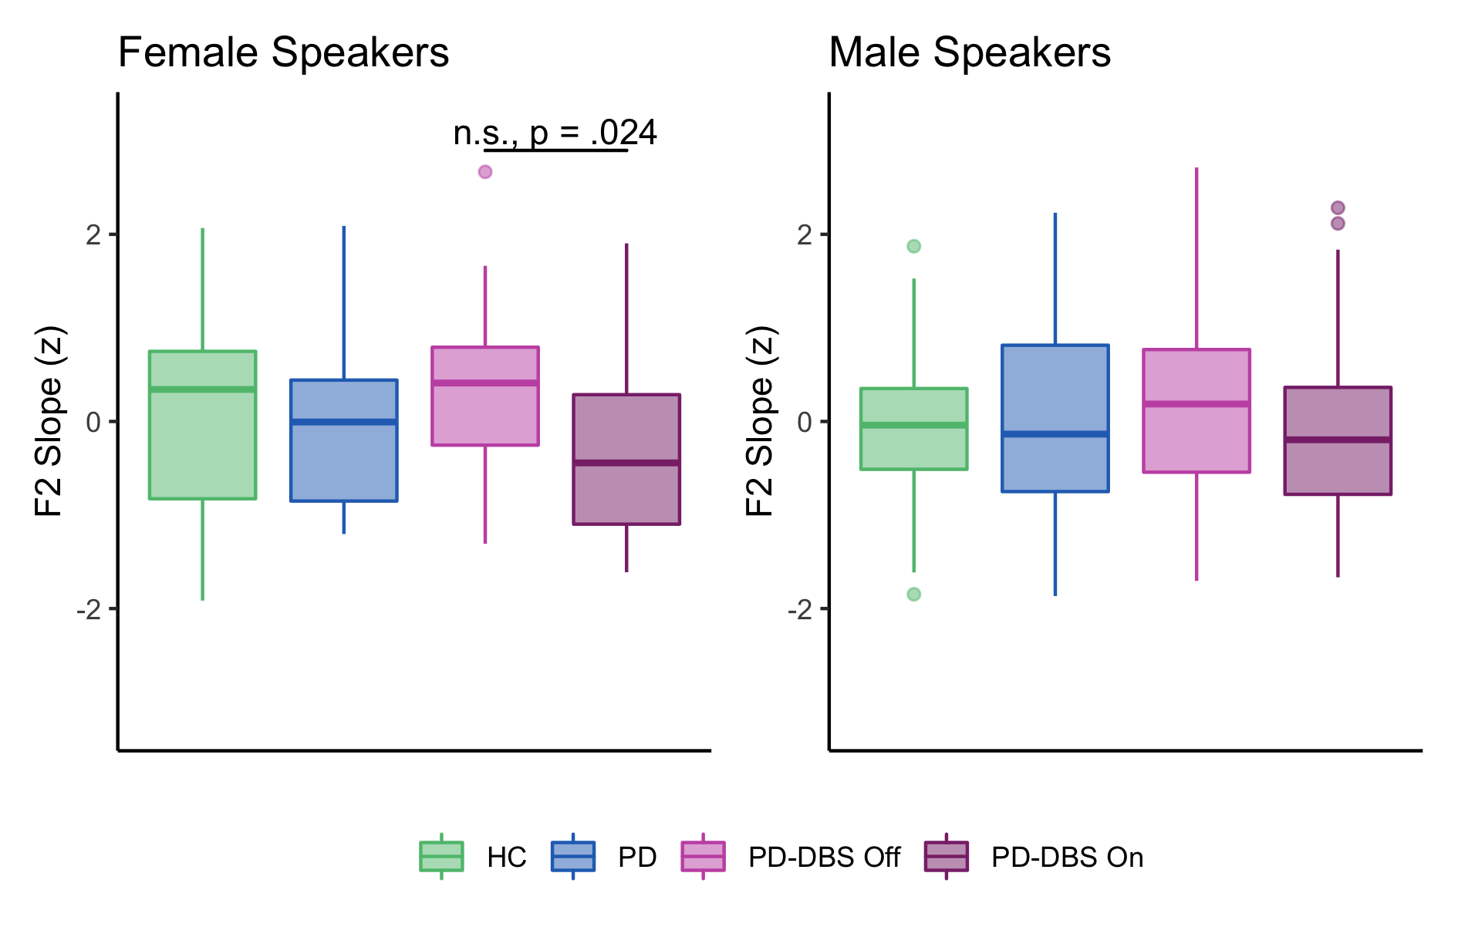
2. F2 Slope (Hz/ms)
There was a n.s. trend of shallower F2 slopes in the DBS On condition, relative to the DBS Off condition.
Not significant at the Bonferonni corrected alpha level

Slide 6
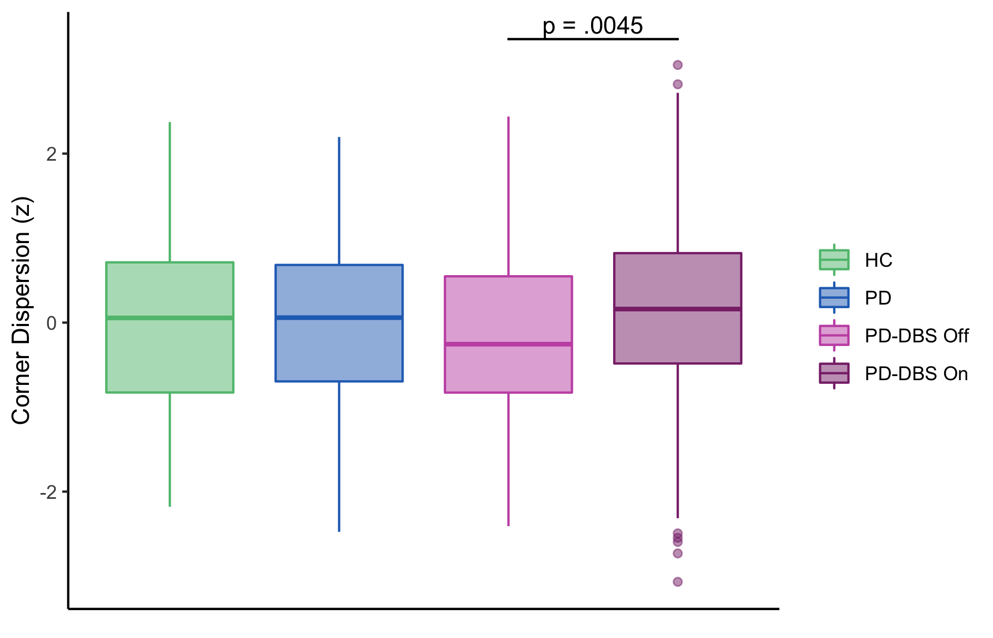
3. Corner Dispersion (Hz)
PD DBS speakers had significantly greater vowel distinctiveness in the DBS On condition, relative to the DBS Off condition.

Slide 7
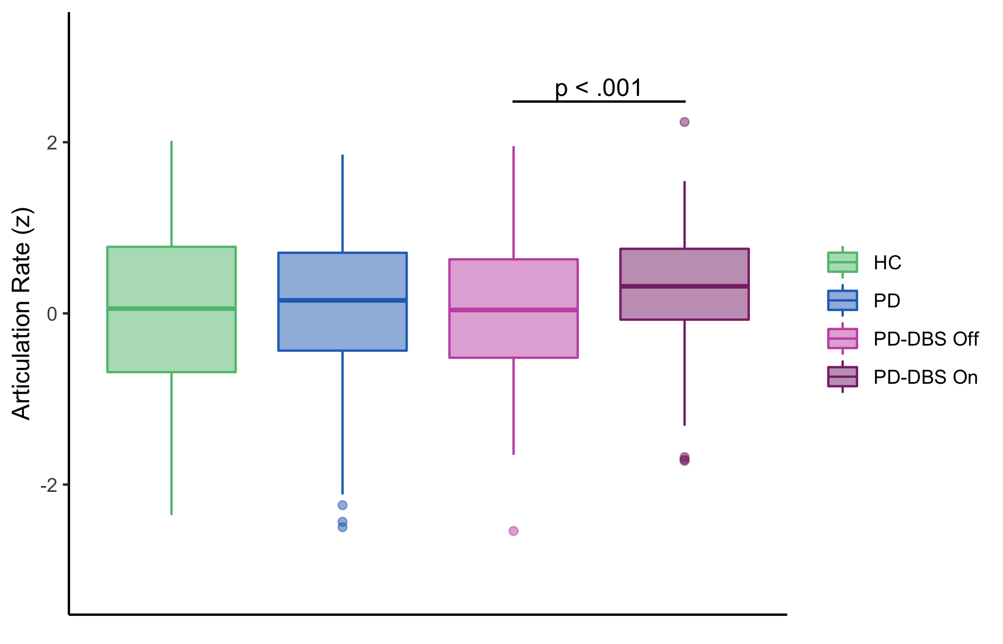
4. Articulation Rate (syl/s)
Speakers with DBS has significantly faster articulation rate in the DBS On condition, relative to the DBS Off condition.

Slide 8
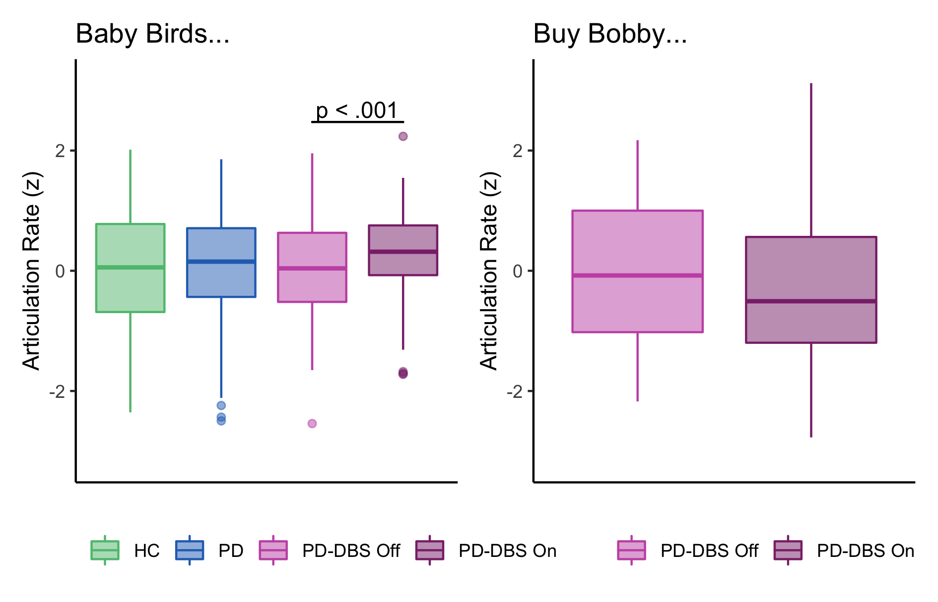
4. Articulation Rate (syl/s) _{Continued}
This finding was task-specific.
Note, statistics were not run for the articulation rate of “Buy Bobby…”

Slide 9
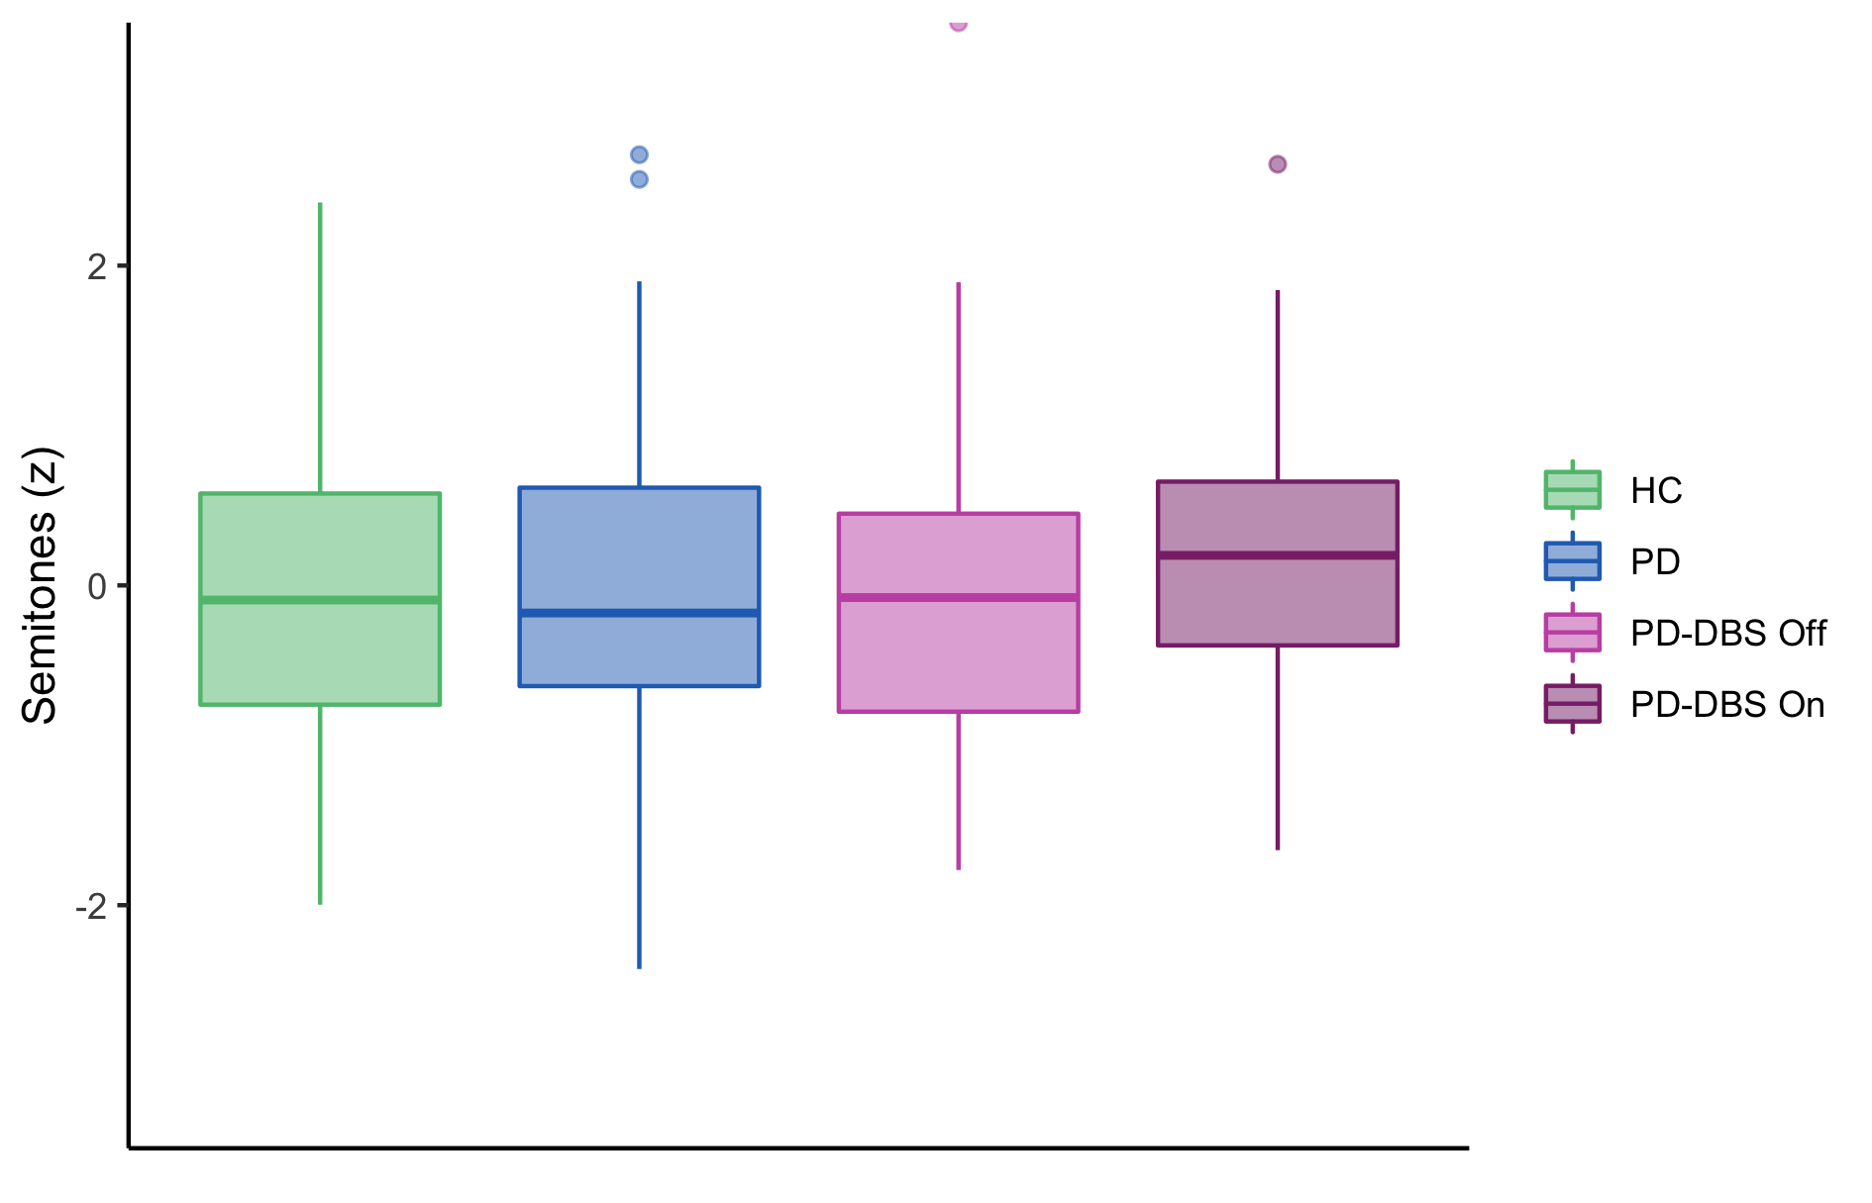
5. F0 Semitone (Hz?)
There was no significant DBS effect for the F0 Semitone measure.

Slide 10
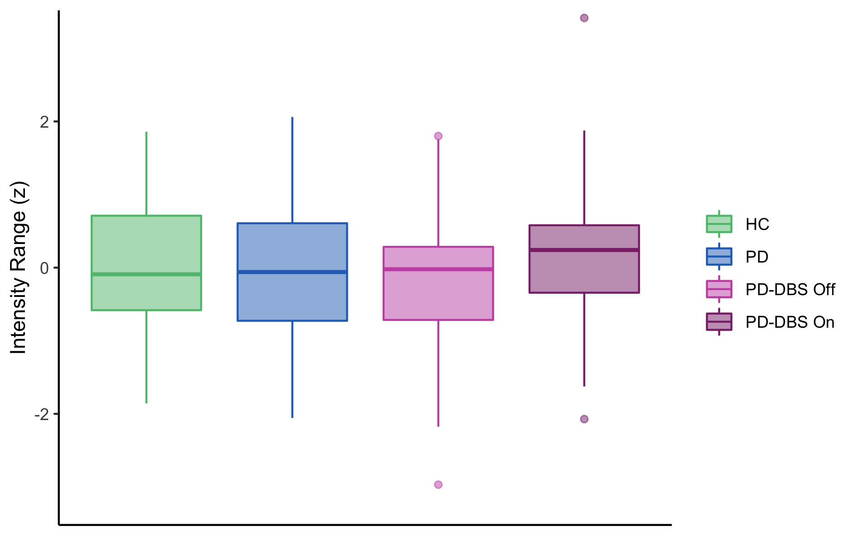
6. Intensity Variation (dB)
There was no significant DBS effect for the Intensity Range measure.

Slide 11
Summary
Voicing proportion during sentences (%)
F2 Slope (Hz/ms) – n.s. trend of Off > On
Corner Dispersion (Hz) – All Speakers: Off < On
Articulation Rate – All Speakers: Off < On
F0 Semitone
Intensity Variation (dB)

